Slide 1
C# Session - 5
By Muhammad Muneeb Ullah Khan

Slide 2
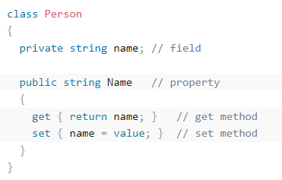
C# Properties (Get and Set)
A property is like a combination of a variable and a method, and it has two methods: a get and a set method:

Slide 3
Example explained
Example explained
The Name property is associated with the name field. It is a good practice to use the same name for both the property and the private field, but with an uppercase first letter.
The get method returns the value of the variable name.
The set method assigns a value to the name variable. The value keyword represents the value we assign to the property.

Slide 4
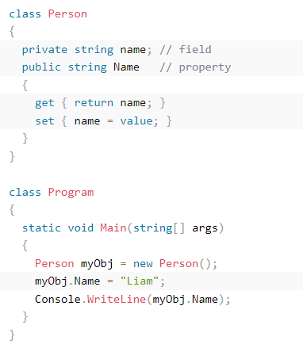
EXAMPLE

Slide 5
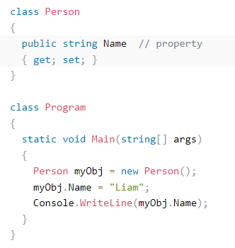
Automatic Properties (Short Hand)
C# also provides a way to use short-hand / automatic properties, where you do not have to define the field for the property, and you only have to write get; and set; inside the property.

Slide 6
OOP PILLARS IN C#
There are 4 pillars of OOP:
Encapsulation
Inheritance
Polymorphism
abstraction

Slide 7
Encapsulation
The meaning of Encapsulation, is to make sure that "sensitive" data is hidden from users. To achieve this, you must:
declare fields/variables as private.
provide public get and set methods, through properties, to access and update the value of a private field.

Slide 8
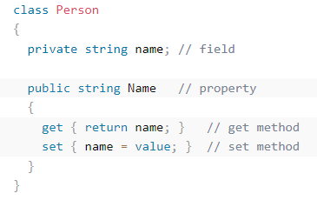
Encapsulation

Slide 9
Inheritance (Derived and Base Class)
In C#, it is possible to inherit fields and methods from one class to another. We group the "inheritance concept" into two categories:
Derived Class (child) - the class that inherits from another class
Base Class (parent) - the class being inherited from
To inherit from a class, use the : symbol.

Slide 10
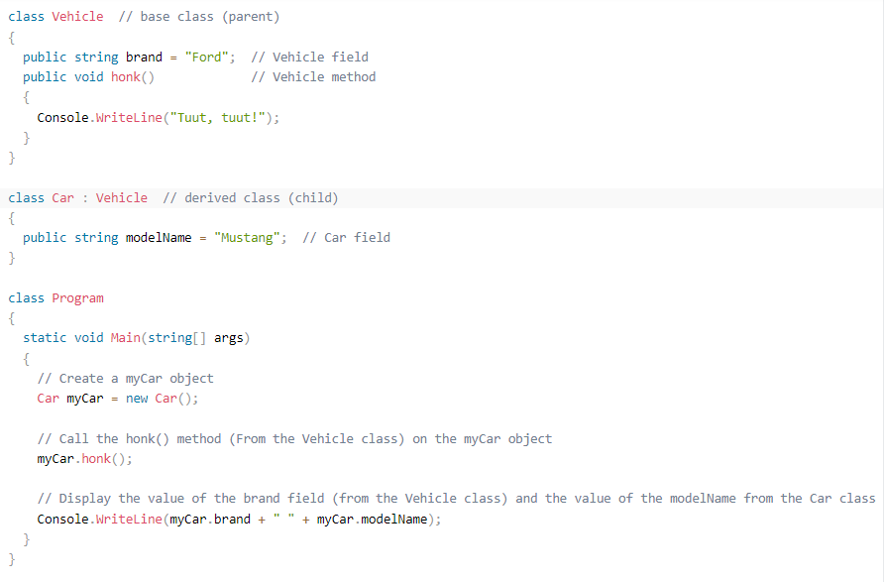
Inheritance (Derived and Base Class)

Slide 11
C# Polymorphism
Polymorphism means "many forms", and it occurs when we have many classes that are related to each other by inheritance.
Inheritance lets us inherit fields and methods from another class. Polymorphism uses those methods to perform different tasks. This allows us to perform a single action in different ways.
For example, think of a base class called Animal that has a method called animalSound() . Derived classes of Animals could be Pigs, Cats, Dogs, Birds - And they also have their own implementation of an animal sound (the pig oinks, and the cat meows, etc.):

Slide 12
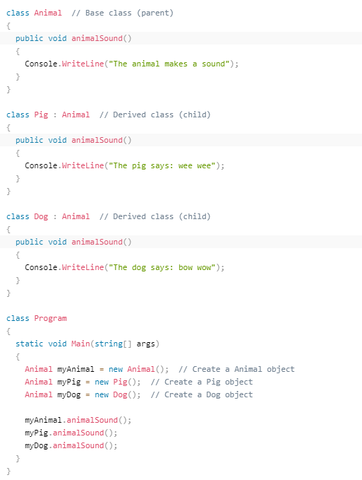
C# Polymorphism

Slide 13
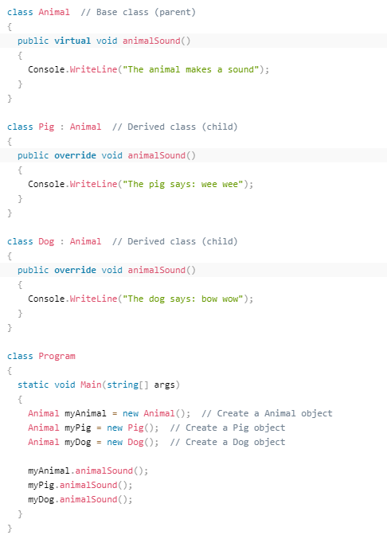
Polymorphism and Overriding Methods

Slide 14
C# Abstraction
Data abstraction is the process of hiding certain details and showing only essential information to the user.
The abstract keyword is used for classes and methods:
Abstract class: is a restricted class that cannot be used to create objects (to access it, it must be inherited from another class).
Abstract method: can only be used in an abstract class, and it does not have a body. The body is provided by the derived class (inherited from).
An abstract class can have both abstract and regular methods:

Slide 15
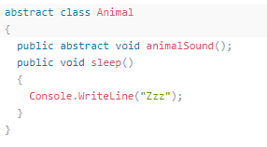

C# Abstraction

Slide 16
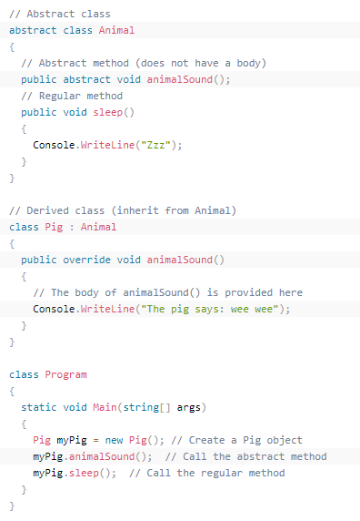
C# Abstraction

Slide 17
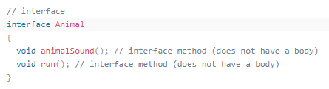
C# Interface
Another way to achieve abstraction in C#, is with interfaces.
An interface is a completely "abstract class", which can only contain abstract methods and properties (with empty bodies):

Slide 18
C# Interface
To access the interface methods, the interface must be "implemented“(kinda like inherited) by another class. To implement an interface, use the : symbol (just like with inheritance). The body of the interface method is provided by the "implement" class. Note that you do not have to use the override keyword when implementing an interface:

Slide 19
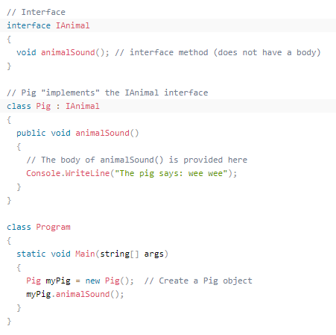
C# Interface

Slide 20
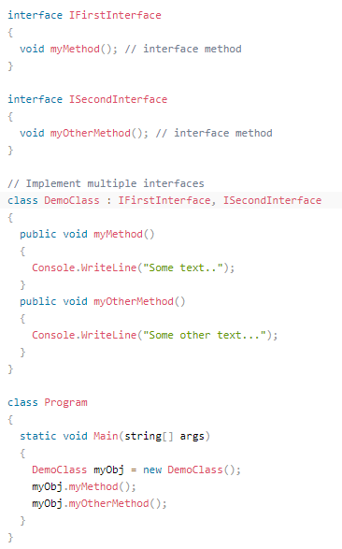
C# Multiple Interfaces

